Slide 1
MRA Project Milestone 1
Contents
Summary of the data
Exploratory Analysis and Inferences
Customer Segmentation using RFM analysis

Slide 2
Data Summary
Info : 12 Object , 7 Integer and 1 datetime
Shape : 2747 rows and 20 columns
No null /missing values
No duplicate columns
Outlier columns - 'ORDERNUMBER', 'QUANTITYORDERED', 'PRICEEACH', 'ORDERLINENUMBER', 'SALES', 'ORDERDATE', 'DAYS_SINCE_LASTORDER', 'MSRP'

Slide 3
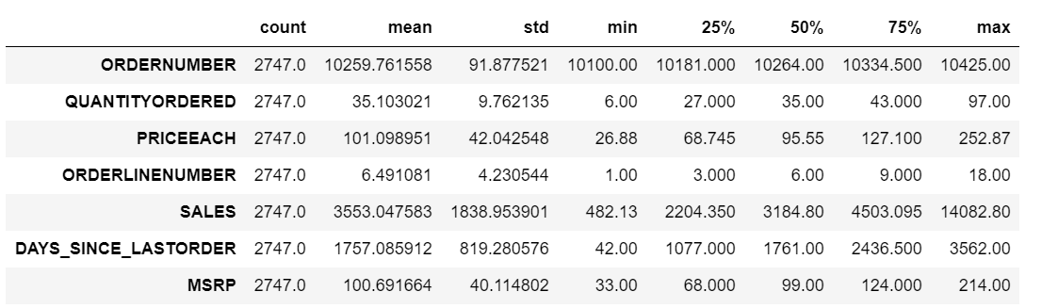
Numerical column description

Slide 4
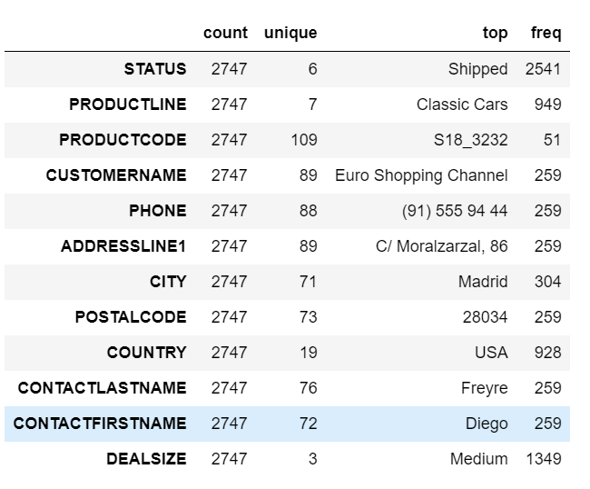
Categorical column description

Slide 5
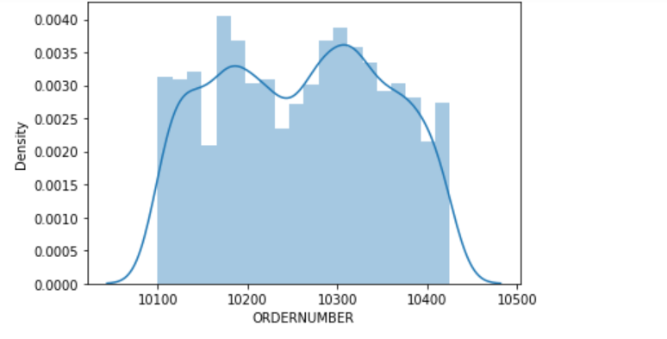
Univariate analysis

Slide 6
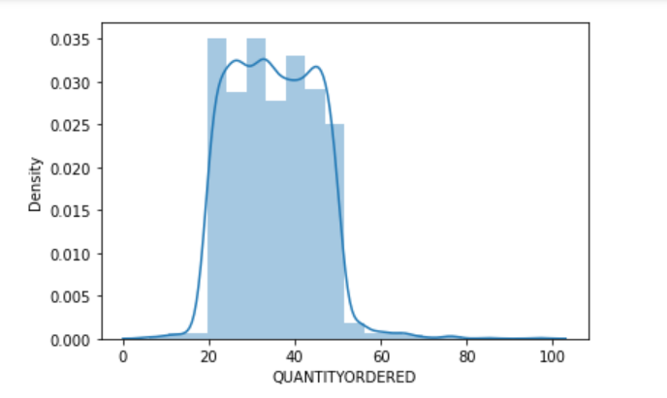

Slide 7
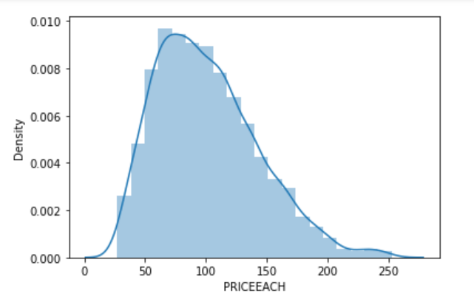

Slide 8
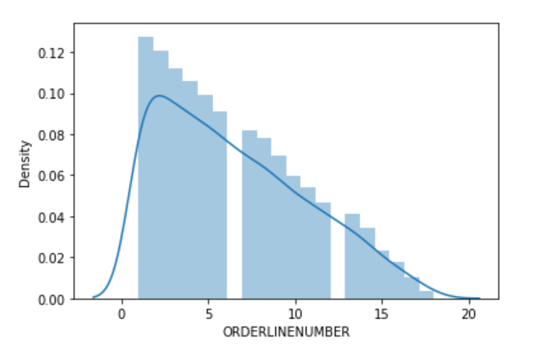

Slide 9
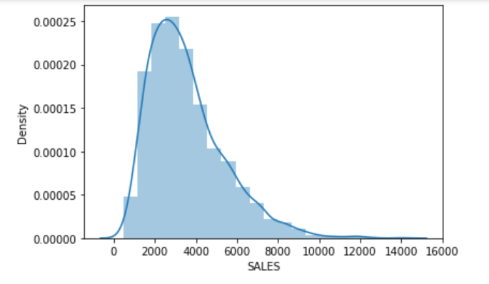

Slide 10
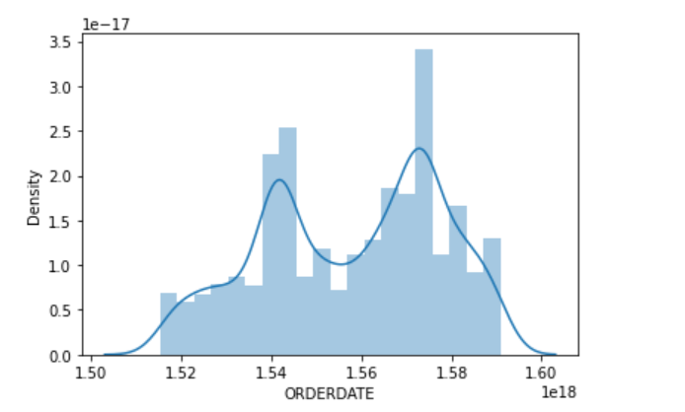

Slide 11
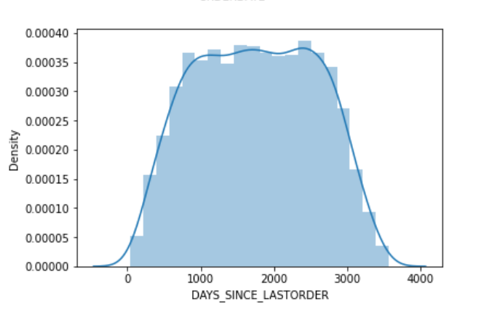

Slide 12
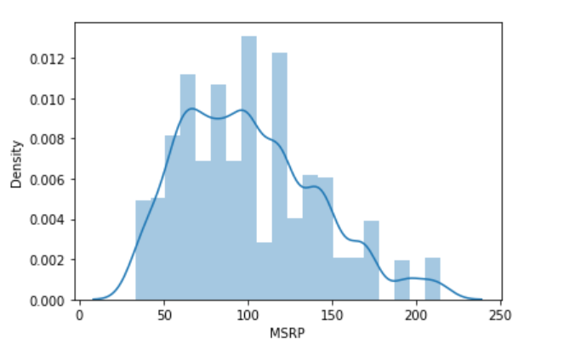

Slide 13
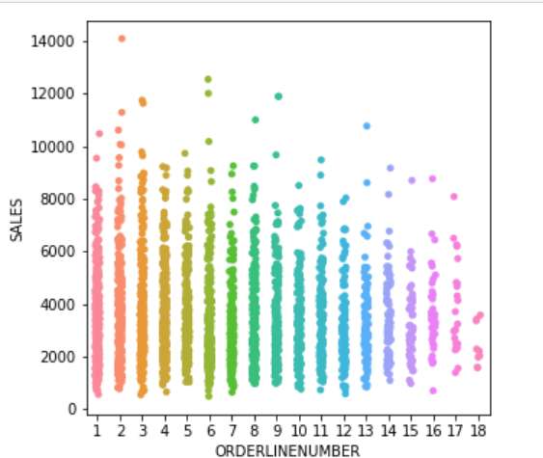
Bivariate Analysis

Slide 14
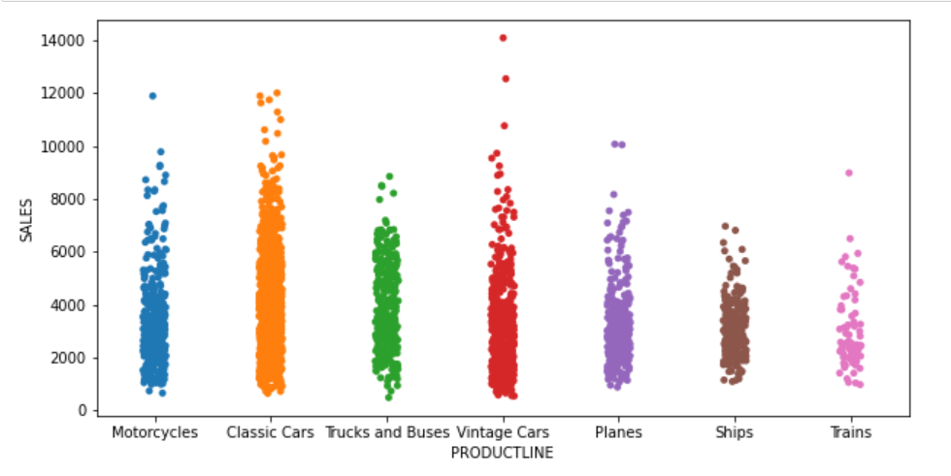

Slide 15
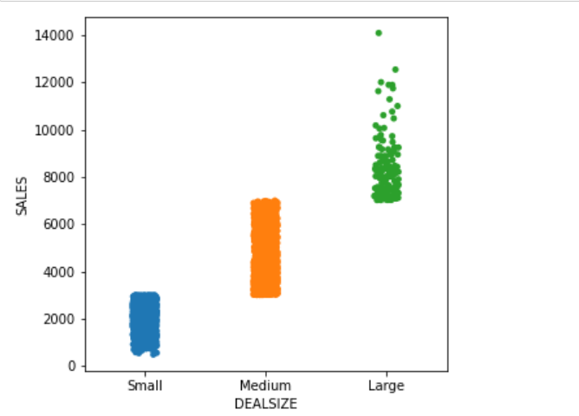

Slide 16
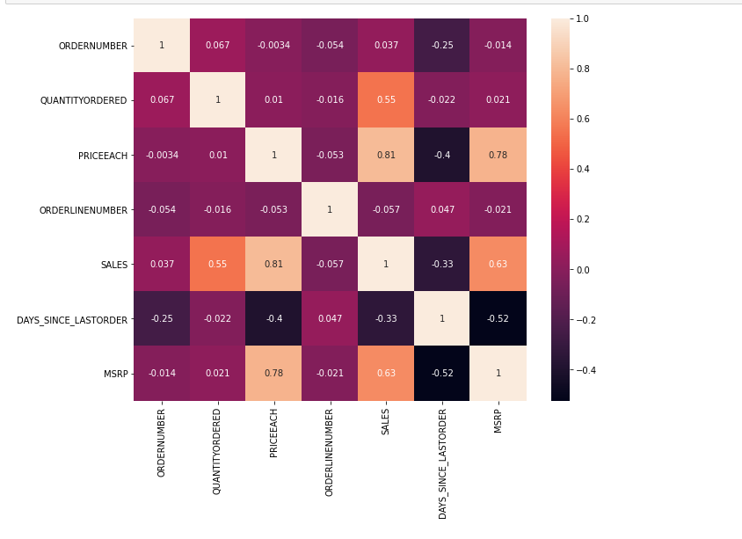
Multivariate Analysis

Slide 17
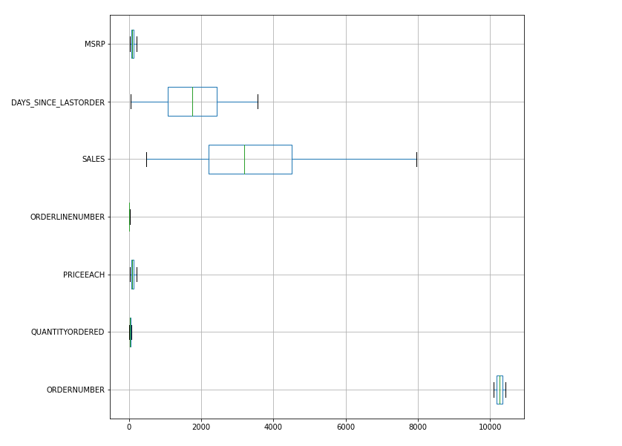
After Outlier treatment

Slide 18
Customer Segmentation using RFM analysis
Tool Used – KNIME
What all parameters used and assumptions made
1) OrderNumber
2) Monetary
3) Recency

Slide 19
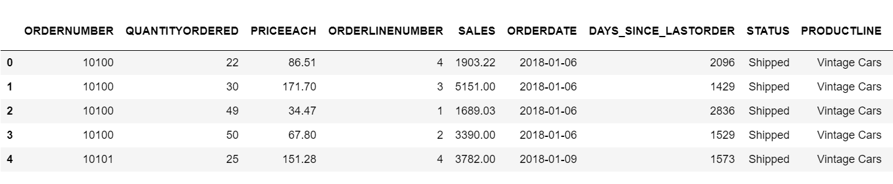
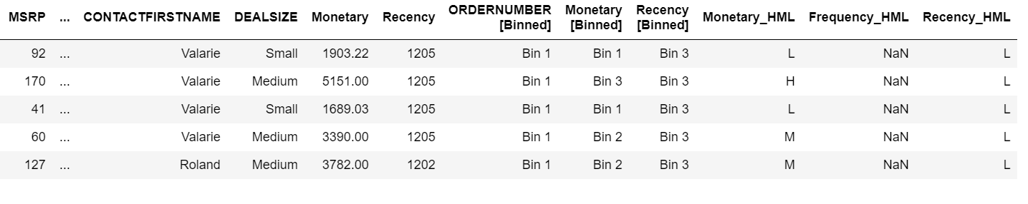
Output table head

Slide 20
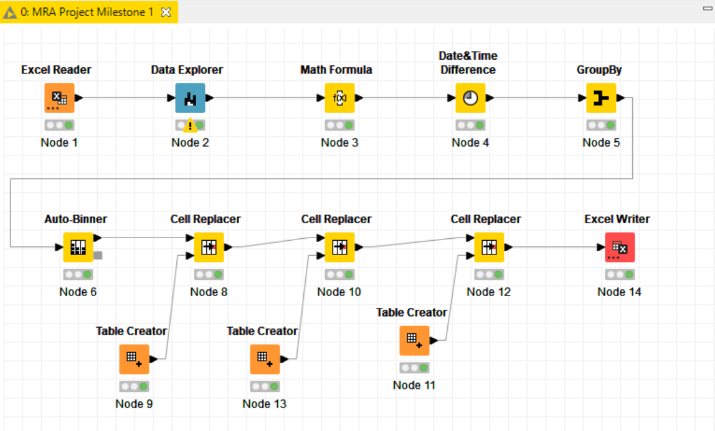
Workflow image

